Slide 1
Union europeenne des medecins specialistes
Dr romuald krajewski
2013

Slide 2
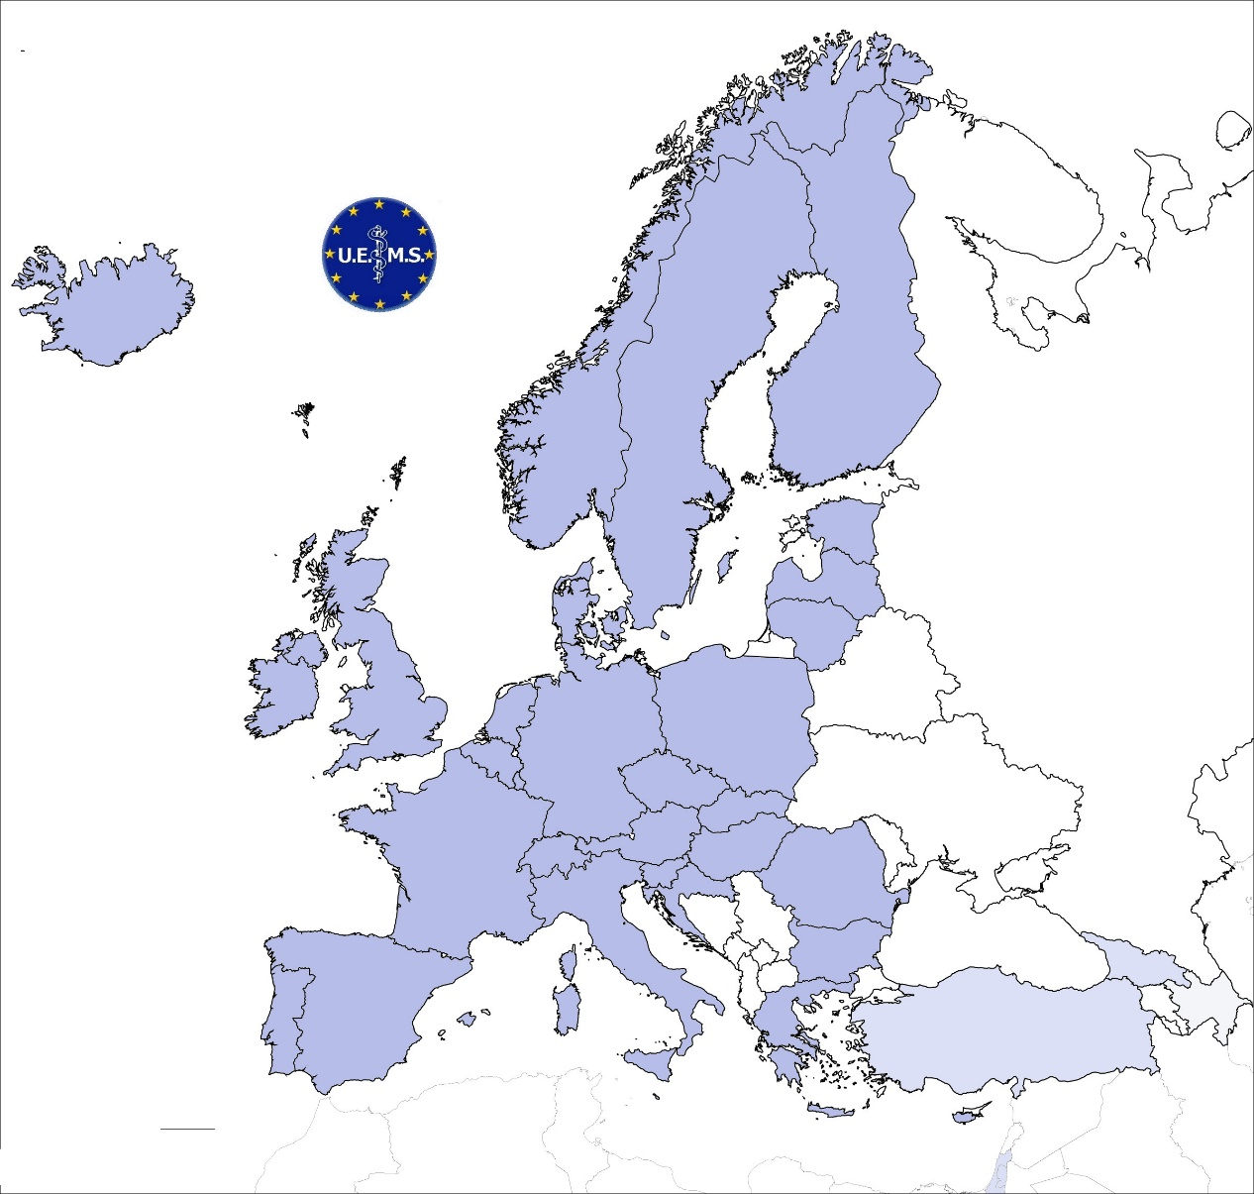
Members:
31 Full, 3 Associated, 1 Observer
> 1 mln. specialists
Established 1958
55

Slide 3
Key activities:
Standards in: PGT/CPD/CME specialist practice
Accreditation of CME/CPD
European specialist examinations
Political lobbying
Established 1958
55

Slide 4
Council
Specialist Sections
Multidisciplinary Joint Committees
Thematic Federations
Board
European Boards
Divisions
Secretariat
Brussels
Working Groups
Task Forces
Committees
Executive
UEMS Standing Committee
on CME/CPD
Governance Board
UEMS Standing Committee
on Quality of
Specialist Practice
Governance Board
UEMS Standing Committee on
Post Graduate Training
Governance Board
UEMS ECAMSQ
European Council for Accreditation
of Medical Specialist Qualification
UEMS EACCME
European Accreditation
Council for CME
UEMS EACQMSP (?)
European Advisory Council
for Quality Management
of Specialist Medical Practice
CESMA

Slide 5
UEMS EACCME
Established in 1999
New Criteria for accreditation of Live Educational Events (UEMS 2012/30)
Criteria for e-Learning Materials (UEMS 2012/20)
Accreditation in 2012
1695 applications for LEE
57 applications for e-Learning
UEMS Standing Committee
on CME/CPD
Governance Board
UEMS EACCME
European Accreditation
Council for CME

Slide 6
Why European accreditation?
Independent accreditation body
International cooperation
Common „currency” (ECMEC)
Explicit standards
Enhanced transparency
Stimulus for improvement

Slide 7
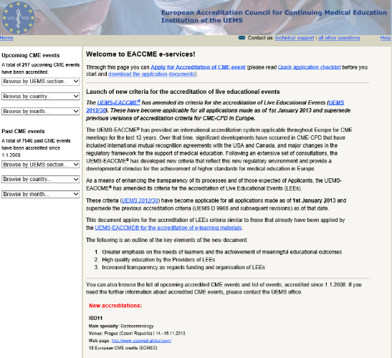
The process
Application
Three independent reviews:
UEMS EACCME (administrative)
Specialist Section or Board (specialist)
National Accreditation Authority (local requirements)
When ALL THREE assessments are positive:
Accreditation

Slide 8
Principles
Event accreditation
Educational value
Declarations of conflict of interest – avoidance of bias
No influence by sponsors
Strict separation from promotional activities

Slide 9
Criteria
Live Educational Events
Description of the event
Details of the Provider
The Faculty
The Programme
Funding
Promotional material
Review by Learners
26 items

Slide 10
European CME/CPD
UEMS policy:
professional/educational mobility
+
high quality of education and competence-based training
+
high quality of specialist care

Slide 11
Cooperation
Voluntary activities based on professional and social responsibility of medical specialists
National Medical Associations
Scientific Societies
Training centers

Slide 12
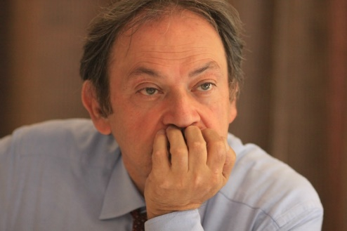
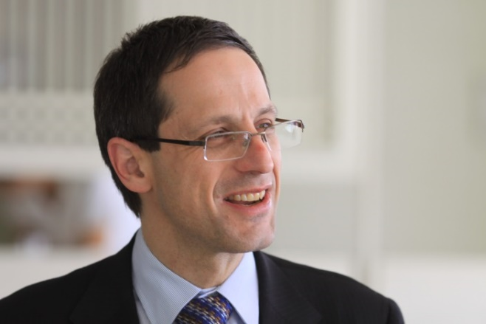
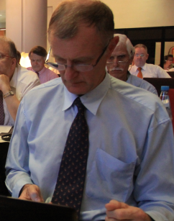
j

